Slide 1
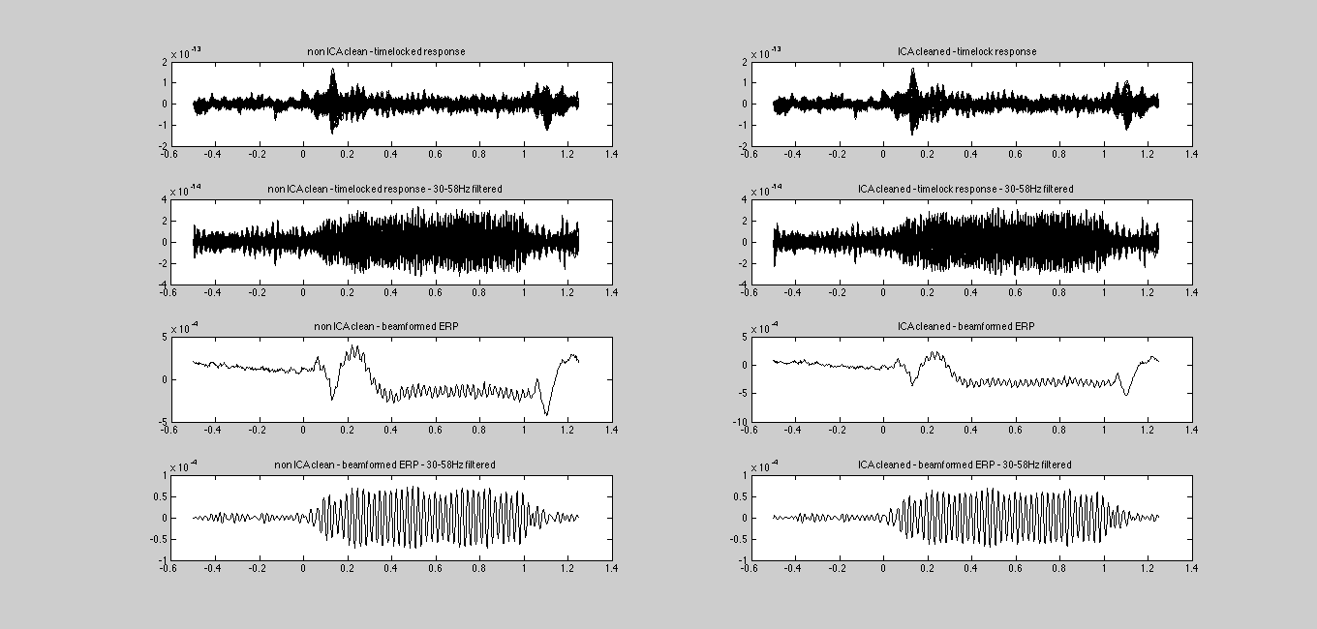
CTF-derived data
BB
All sensors
BP
BB
Virtual Electrode
BP
Non-ICA corrected data
(I.E. just read in and averaged)
ICA corrected data
(EOG/ECG corrected data)
BB – Broadband (3-200Hz); BP – Bandpassed (30-58Hz)

Slide 2
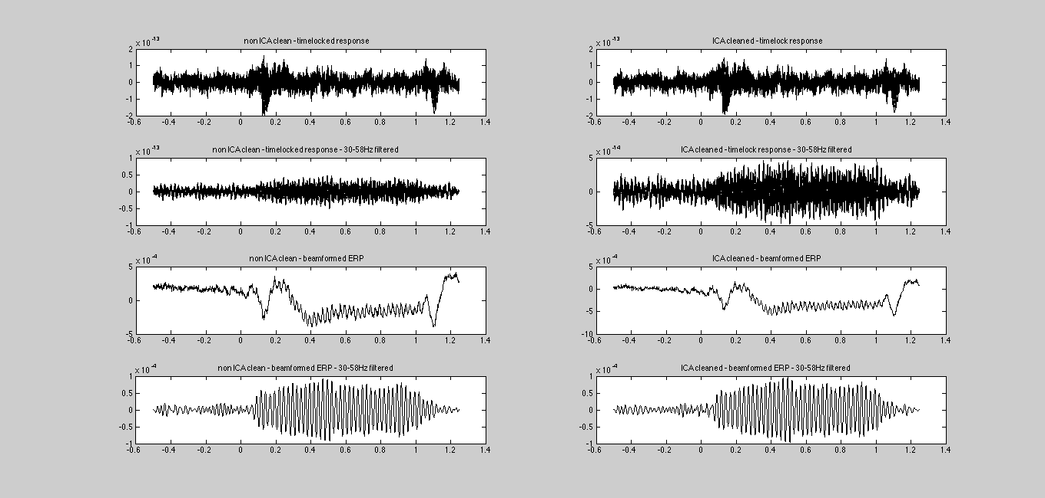
Elekta MAG-derived data
BB
All sensors
BP
BB
Virtual Electrode
BP
Non-ICA corrected data
(I.E. just read in and averaged)
ICA corrected data
(EOG/ECG corrected data)
BB – Broadband (3-200Hz); BP – Bandpassed (30-58Hz)

Slide 3
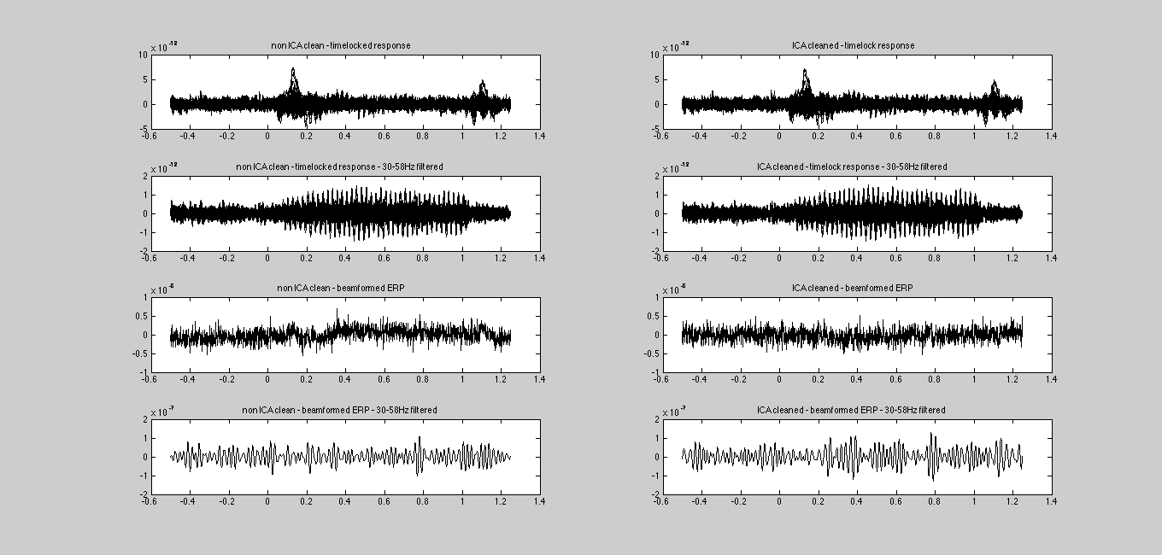
Elekta GRAD-derived data
BB
All sensors
BP
BB
Virtual Electrode
BP
Non-ICA corrected data
(I.E. just read in and averaged)
ICA corrected data
(EOG/ECG corrected data)
BB – Broadband (3-200Hz); BP – Bandpassed (30-58Hz)

